Slide 1

Module 8: Data Visualization
DS 522 Data Acquisition and Analytics

Slide 2
AGENDA
Plotting and Visualization using matplotlib
Figures and Subplots
Colors, Markers, and Line Styles
Ticks, Labels, and Legends
Plotting with Pandas and Seaborn

Slide 3
Plotting and Visualization with matplotlib

Slide 4

Plotting and Visualization
matplotlib
- a desktop plotting package designed for creating publication-quality plots.
- enables a MATLAB-like plotting interface in Python.
- supports various GUI backends on all operating systems
- can export visualizations to various graphics formats: PDF, SVG, JPG, PNG, etc.
Execute the following code to use matplotlib in Jupyter Notebook:

Slide 5
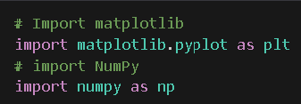
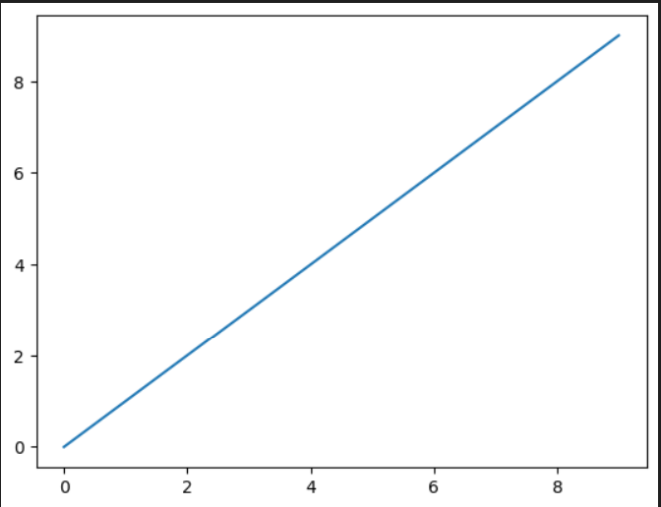
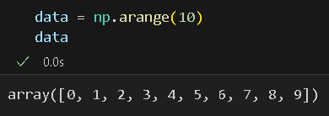

matplotlib API
Import necessary libraries using import convention:
Example:
Customizing options are possible from the matplotlib API.

Slide 6
Figures and Subplots

Slide 7
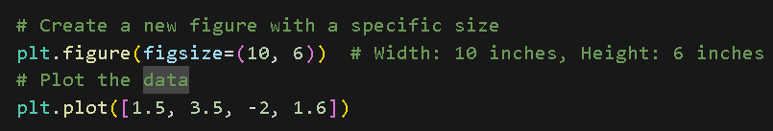
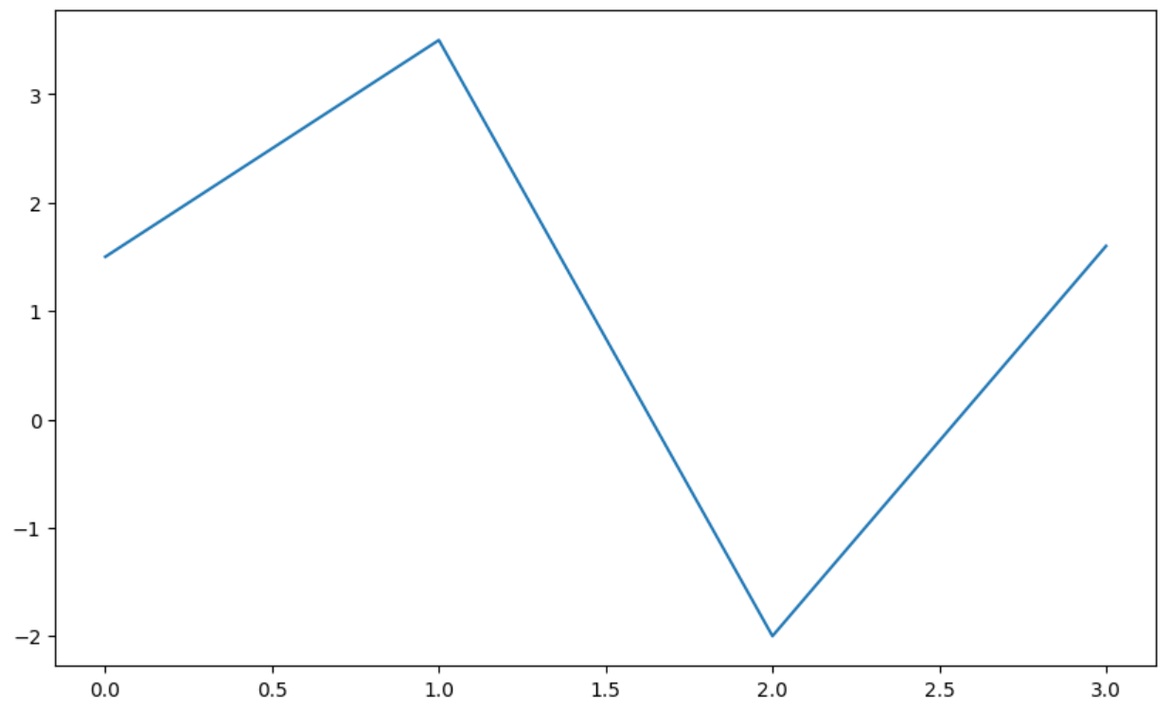
Figures and Subplots
Plots in matplotlib reside within a Figure object.
plt.figure - creates a new figure
figsize – option to set the figure at a certain size and aspect ratio if saved to disk.
Example:

Slide 8
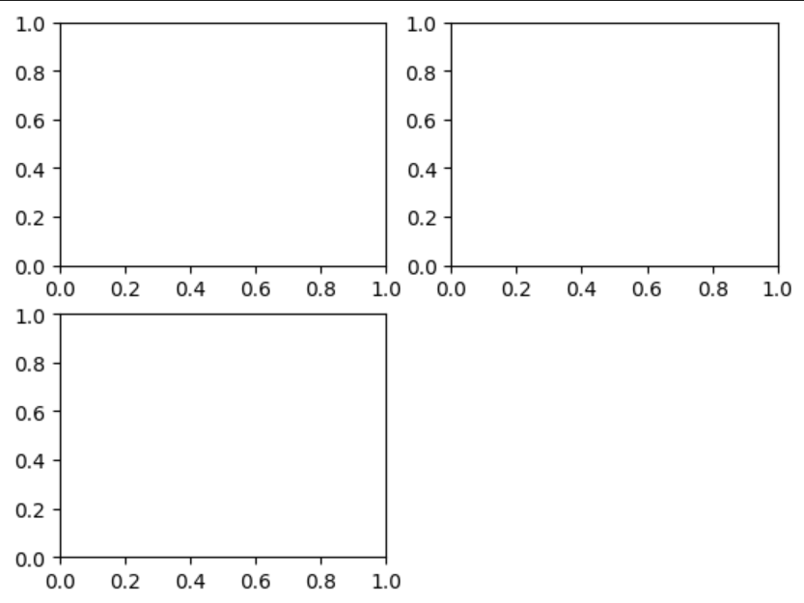
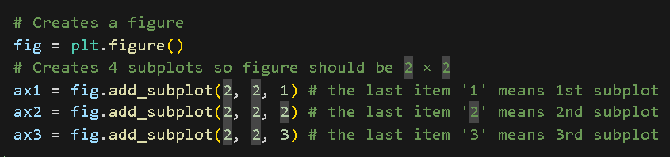
Figures and Subplots
add_subplot - creates one or more subplots
Example:
# The (2, 2, 1) represents (row, columns, location)
and means there are four figures.

Slide 9
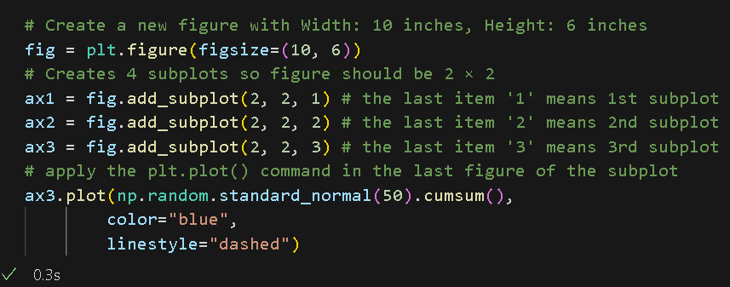
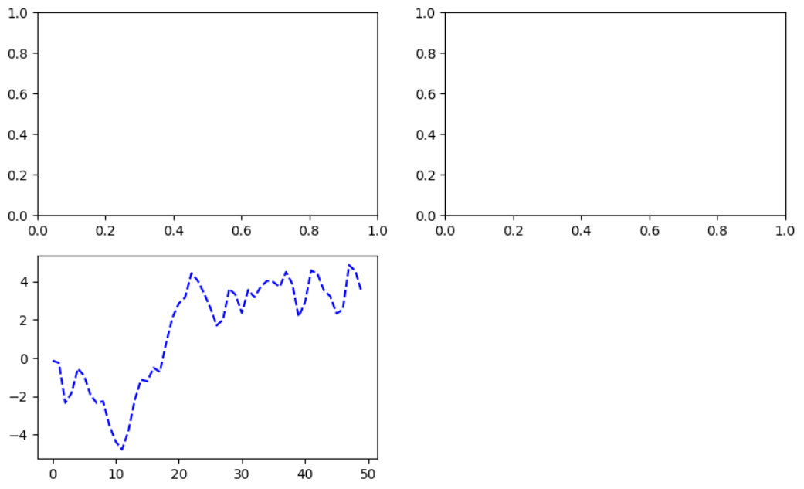
Figures and Subplots
plt.plot() command is applied in the last figure of the subplot.

Slide 10
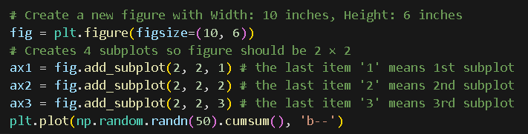
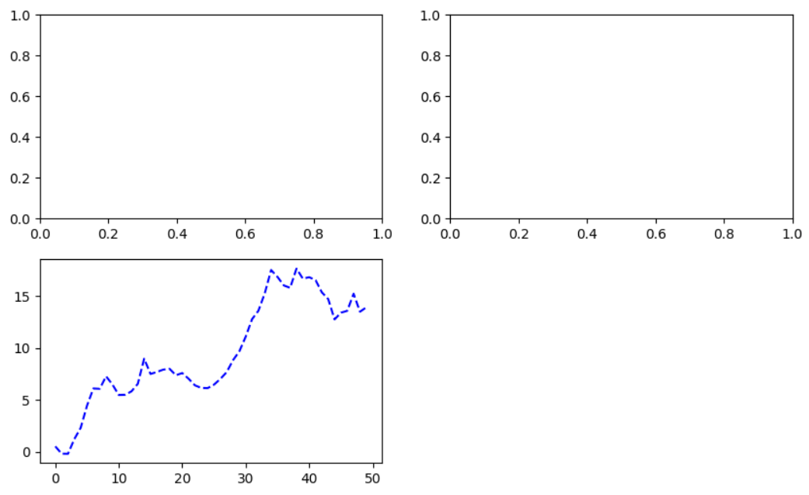
Figures and Subplots
This is equivalent to the previous code
# ‘b--’ in the command is a style option instructing to plot a blue dashed line.

Slide 11
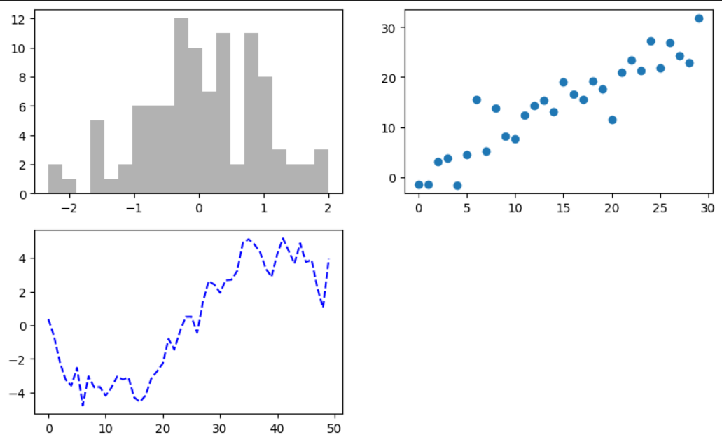
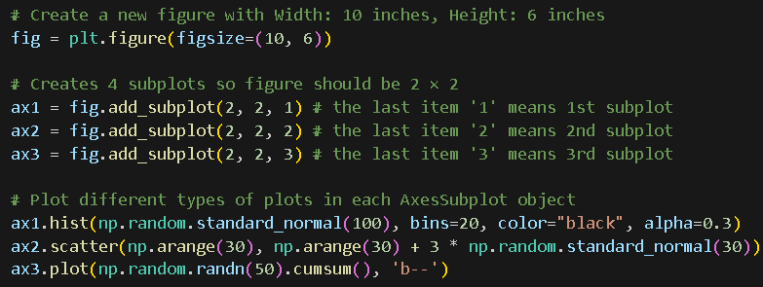
Figures and Subplots
You can plot different types of graphs on a particular subplot.
Notes:
For a comprehensive catalog of plot types, you can refer to http://matplotlib.sourceforge.net

Slide 12
COLORs and markers

Slide 13
Colors, Markers, and Line Styles
matplotlib’s main plot function accepts arrays of x and y coordinates and a string abbreviation indicating color and line style. (e.g. b--)
Plot x vs. y with green dashes:
ax.plot(x, y, 'g--’)
Using more explicit format which is equivalent to the above snippet:
ax.plot(x, y, linestyle = ‘--’, color = ‘g’)
Colors:
{'b', 'g', 'r', 'c', 'm', 'y', 'k', 'w’} -> {blue, green, red, cyan, magenta, yellow, black, white}
execute help(plt.plot) - prints a docstring showing the full set of line styles

Slide 14
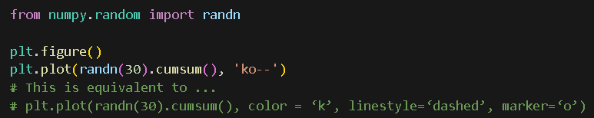
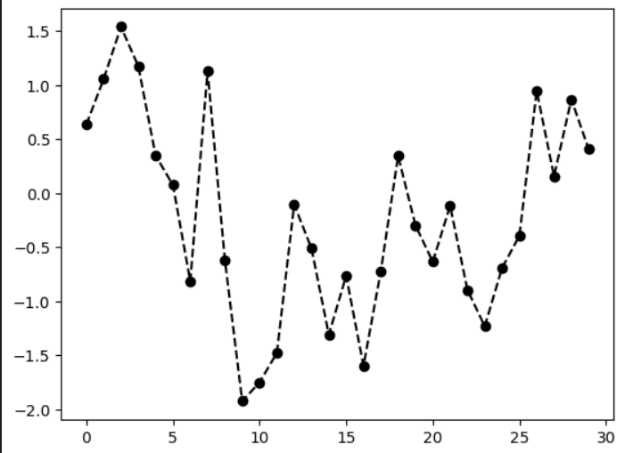
Colors, Markers, and Line Styles
We can use markers to highlight the actual data points using line plots.
It helps users to see where the points lie.

Slide 15
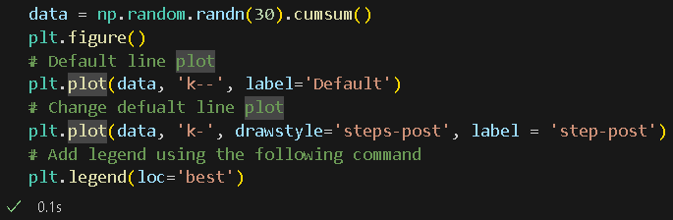
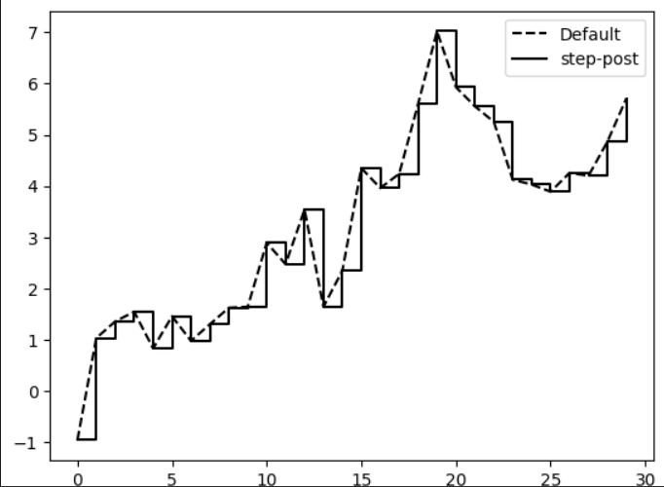
Colors, Markers, and Line Styles
drawstyle – option to plot using different style instead of the default line plot.

Slide 16
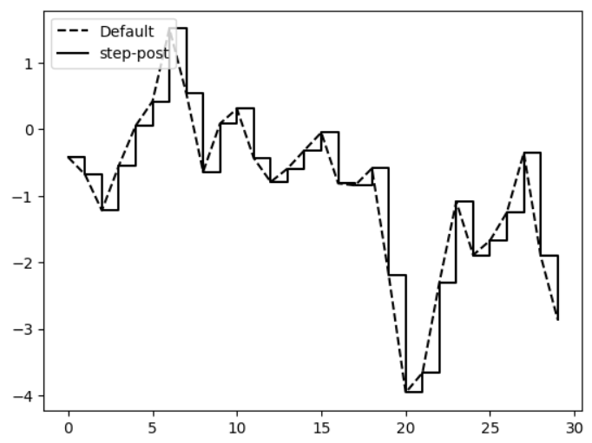
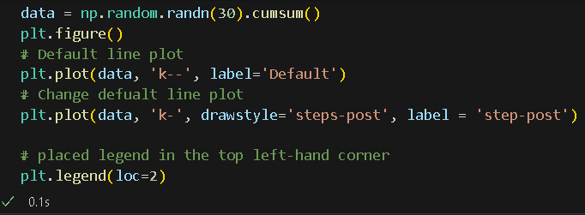
Colors, Markers, and Line Styles
plt.legend allows us to select the location of the legend. (compare plot with previous slide)

Slide 17
Ticks, Labels, and Legends

Slide 18
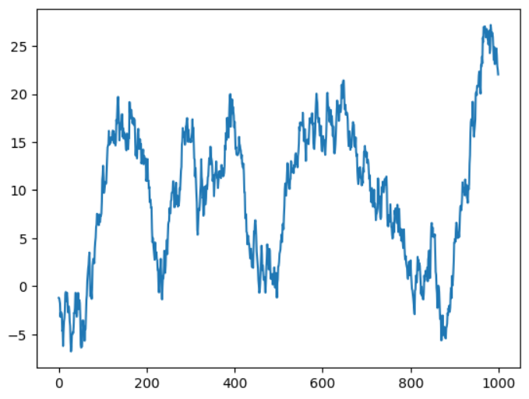
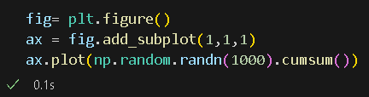
Setting the title, axis labels, ticks, and ticklabels
Let’s consider another example using the following codes:

Slide 19
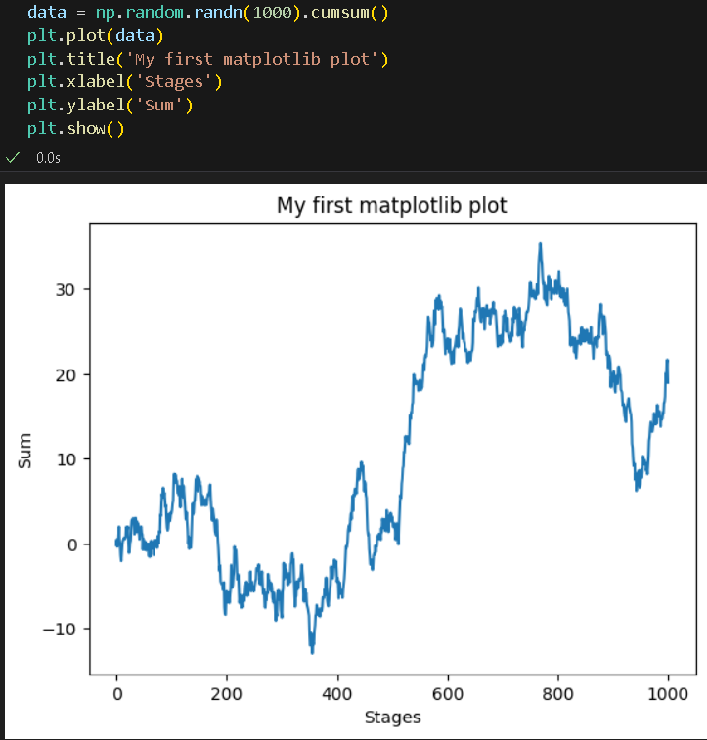
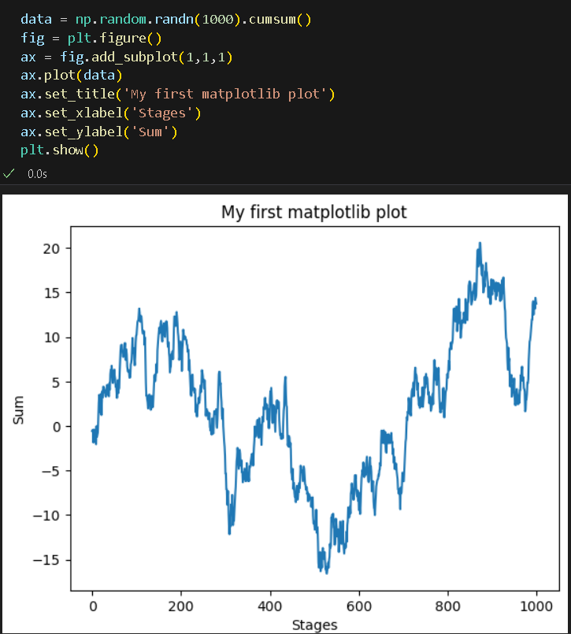
Setting the title, axis labels, ticks, and ticklabels
Add titles and x-label using title or set_title and xlabel or set_xlabel.

Slide 20
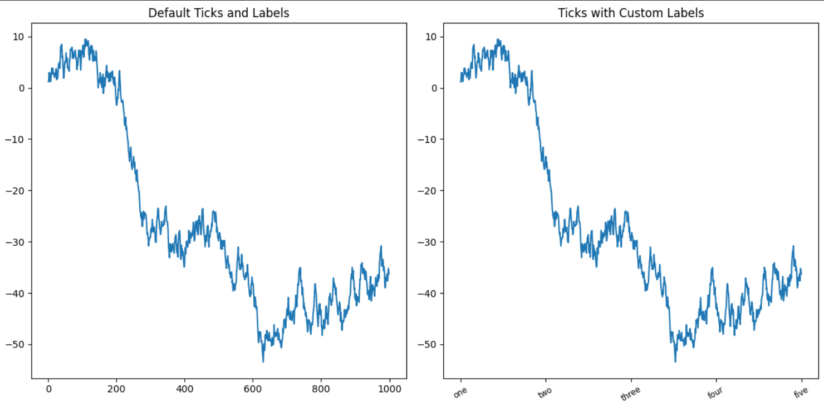
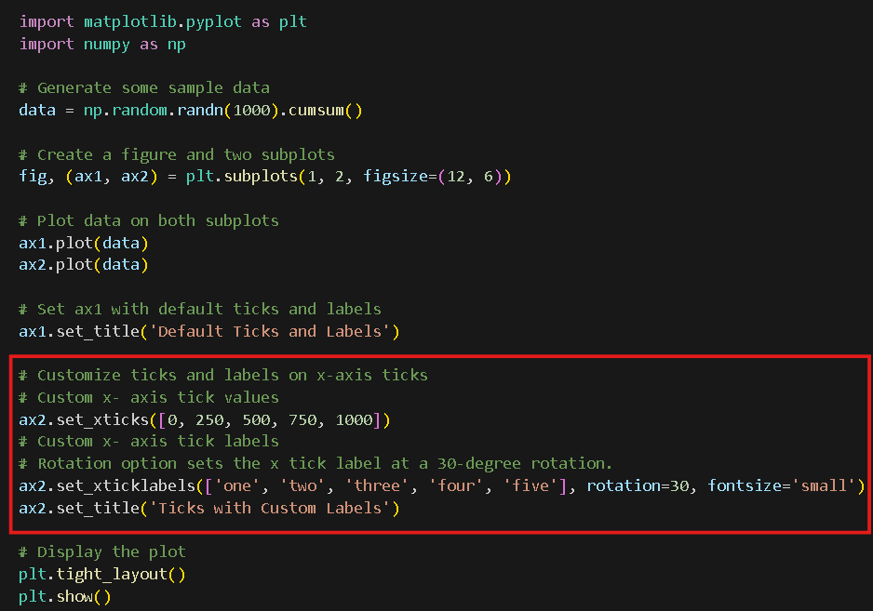
Setting the title, axis labels, ticks, and ticklabels
set_xticks and set_xticklabels – use to change the x-axis ticks

Slide 21
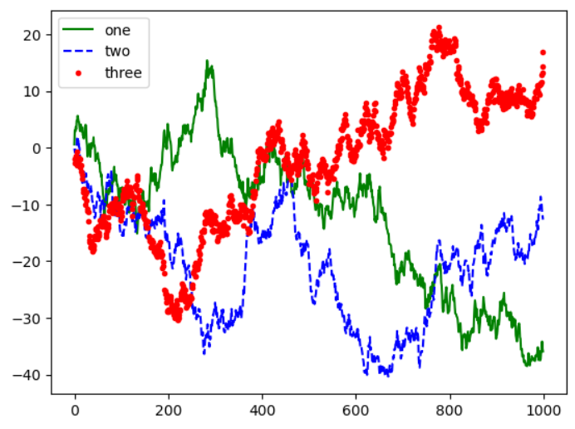
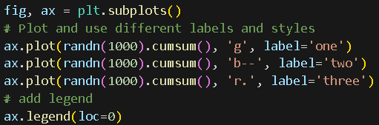
Ticks, Labels, and Legends: Adding Legend
Legends are important when there are different variables on the same plot.

Slide 22
Plotting with Pandas and seaborn

Slide 23
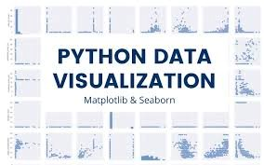
pandas and seaborn
matplotlib allows low-level plots for data display including line, bar, box, scatter, etc.) and standard formatting (legend, title, labels, etc.)
For multiple columnar data, we can use pandas which has built-in methods for visualizations for DataFrame and Series objects.
Seaborn is another library option that allows statistical visualization of data.

Slide 24
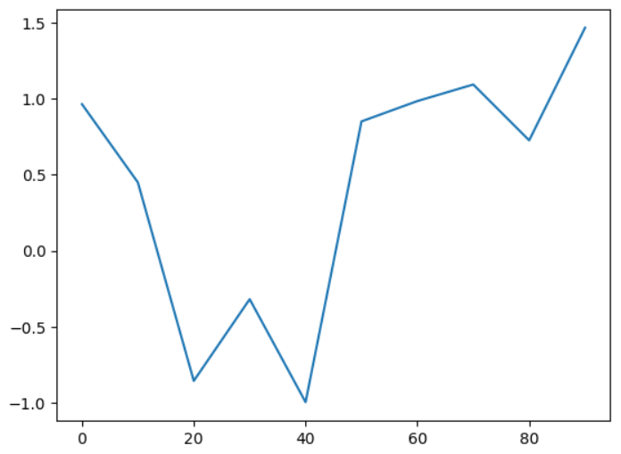
Line Plots
Series and DataFrame have a plot attribute for basic plot types:
plot() to make line plots
xticks and xlim adjust x-axis ticks and limits
yticks and ylim adjust in y-axis ticks and limits

Slide 25
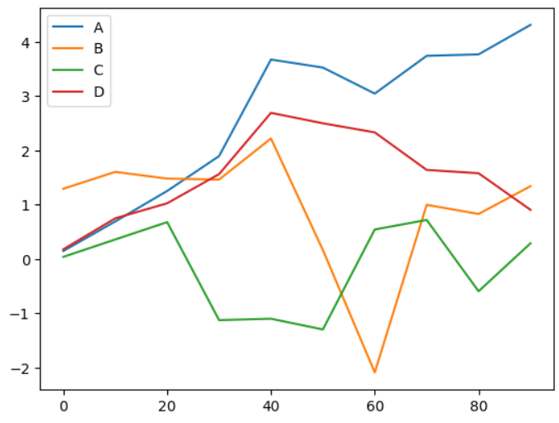
Line Plots
DataFrame’s plot method can make plots for each column using a different line on the same plot.
A legend is automatically created.

Slide 26
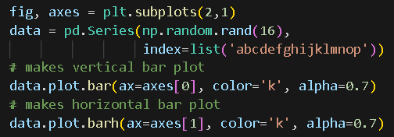
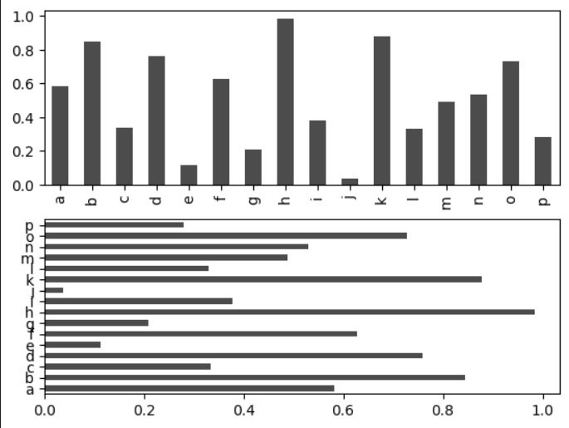
Bar Plots
plot.bar() makes vertical bar plot
plot.barh() makes horizontal bar plot
Series or DataFrame index are used as the x (bar) or y(barh) ticks.
The option color=‘k’ and alpha=0.7 define the color to black and the degree of transparency on the filling.

Slide 27

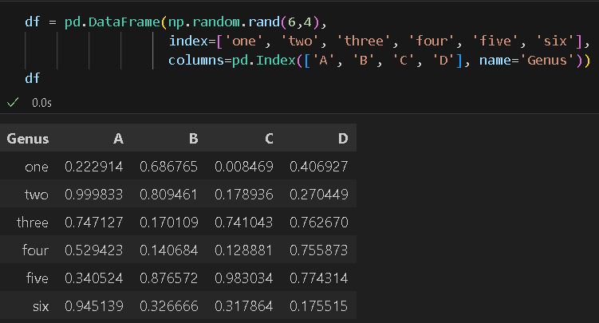
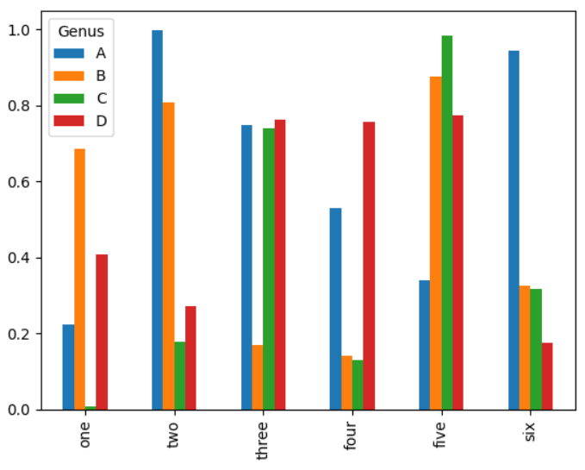
Bar Plots
With a DataFrame, we can create a bar plot that groups the values in each row together in a group in bars, side by side.

Slide 28

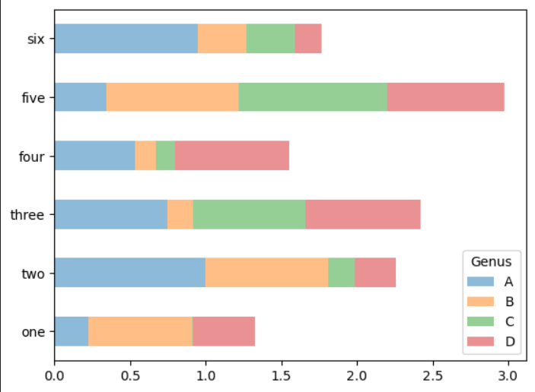
Bar Plots
stacked=True – creates stacked bar plots when passed and allows the values in each row being stacked together.

Slide 29
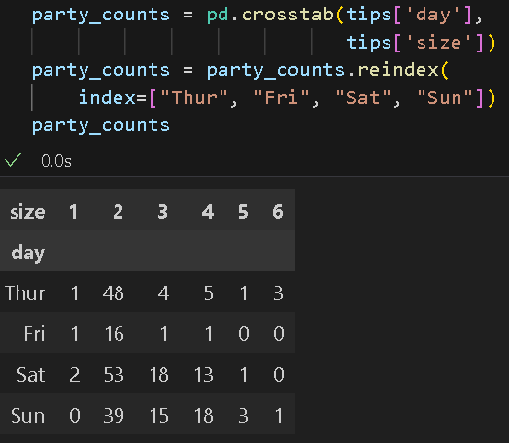
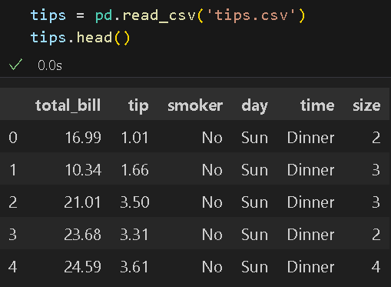
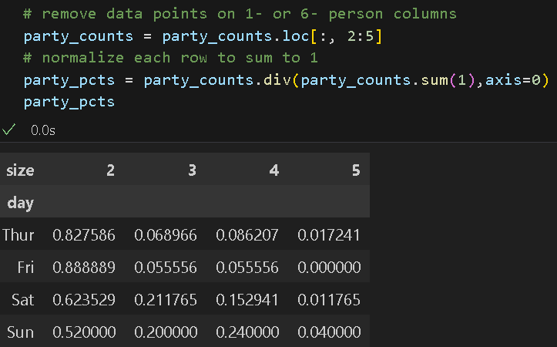
Bar Plots
2
1
Example: dataset on restaurant tipping and display a stacked bar plot showing the percentage of data points for each party size on each day.
We can make cross-tabulation by day and party size
3

Slide 30
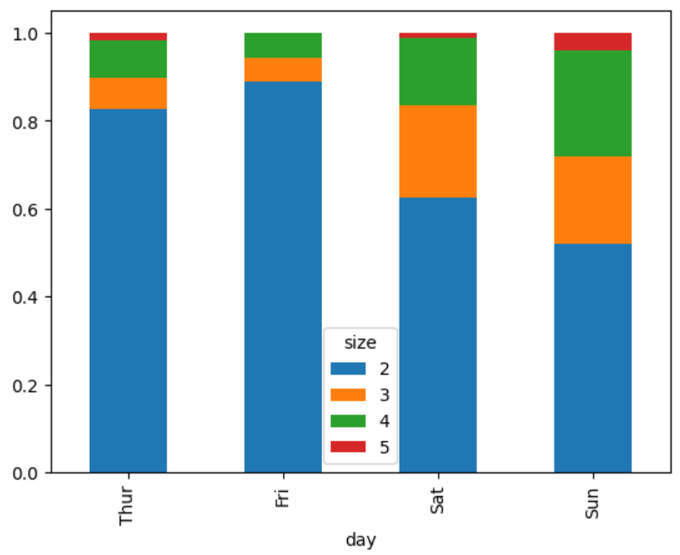
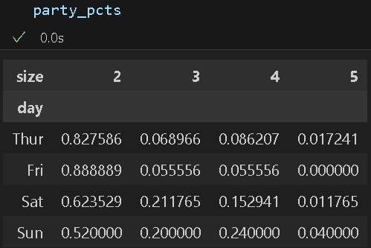

Bar Plots
The bar plot can be created based on the normalized table.

Slide 31


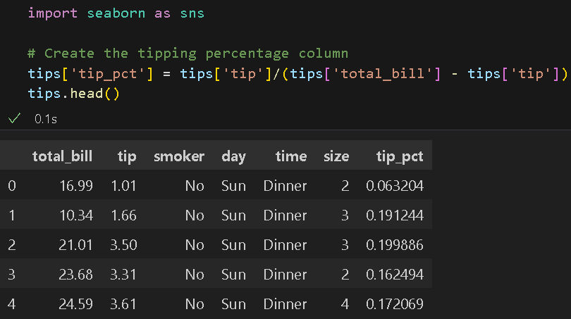
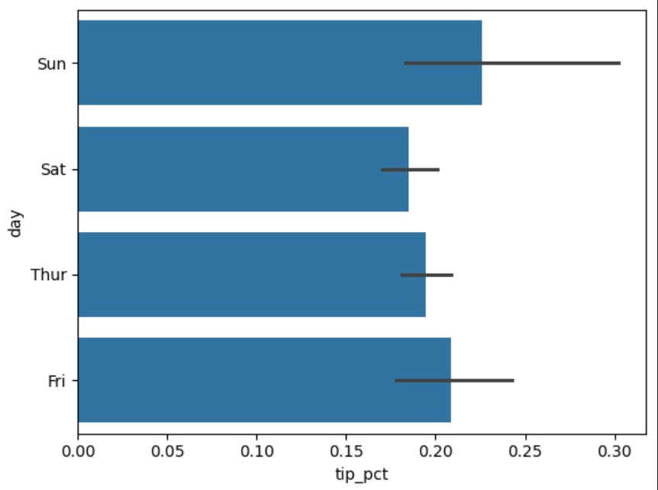
Bar Plots - seaborn
seaborn package can aggregate or summarize before making a plot, making things simpler.
data argument can be a DataFrame
Each bar represents the average value.
The black lines on the bars represent 95% confidence interval.

Slide 32
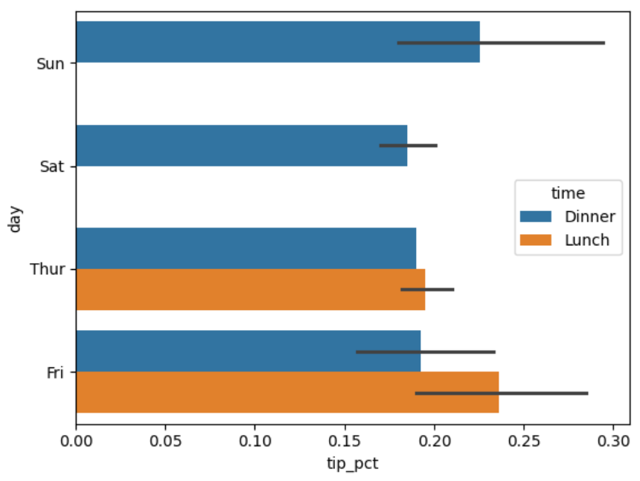
Bar Plots - seaborn
hue option allows to split data into a categorical variable

Slide 33
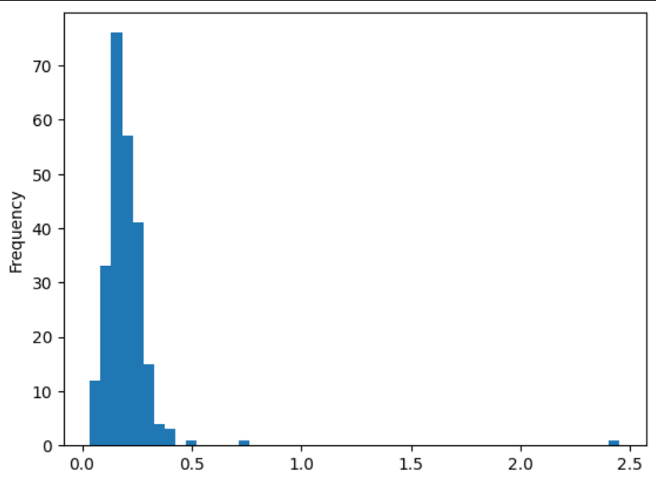

Histograms and Density Plots
We can create a discretized display of value frequency using a histogram.
- Splits data points into evenly spaced bins and the number of data points in each bin are displayed.
plot.hist method to make a histogram.

Slide 34
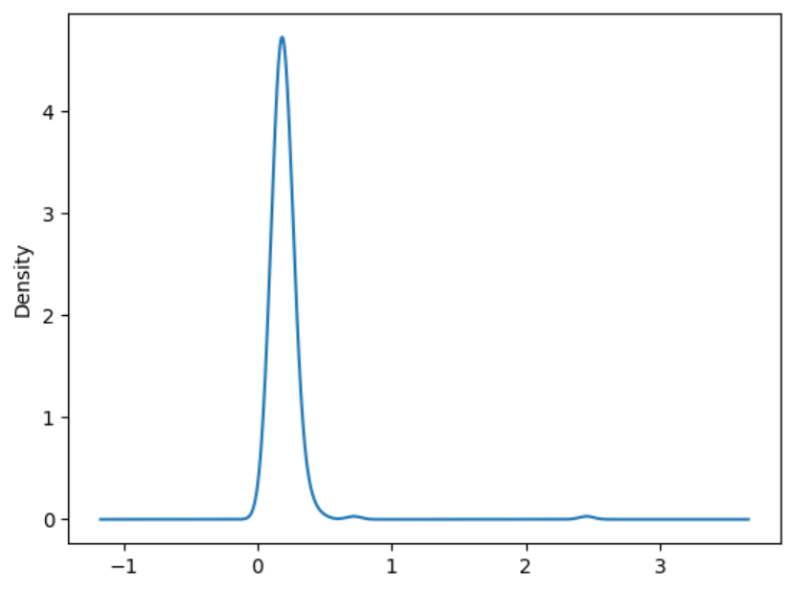


Histograms and Density Plots
plot.density() creates a density plot
provides probability distribution that might have generated the observed data.

Slide 35
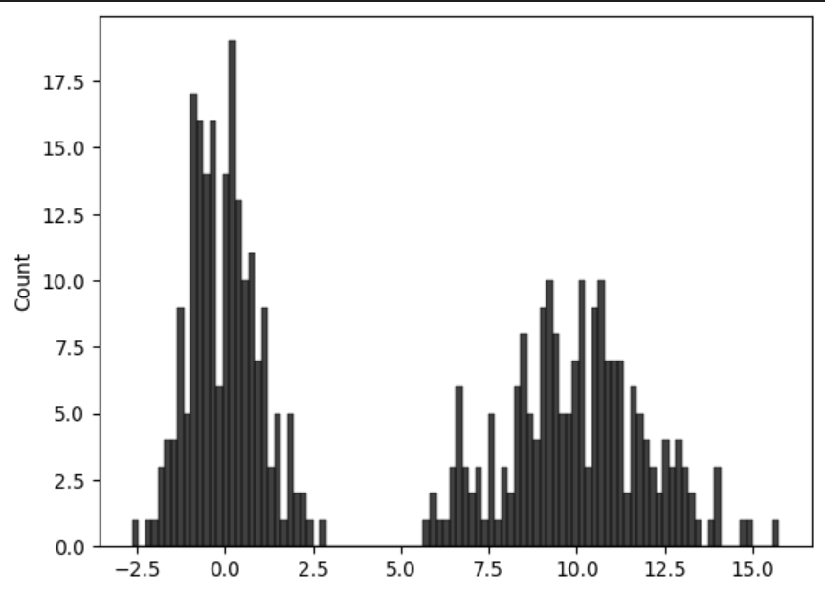
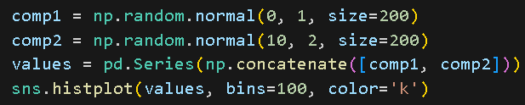
Histograms and Density Plots
seaborn allows histograms and density plots together using histplot method.
We can consider a bimodal distribution consisting of draws from two different standard normal distributions.

Slide 36
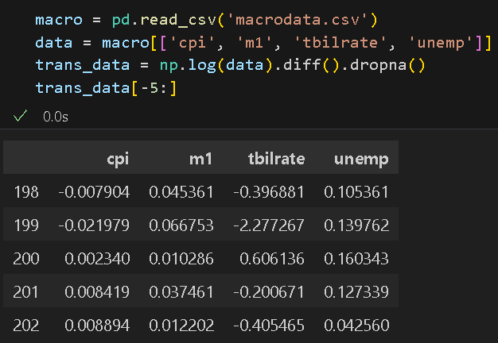
Scatter or Point Plots
Scatter plots can be a useful way to examine the relationship between two variables or one-dimensional data series.
Example: log difference from microdata dataset.

Slide 37
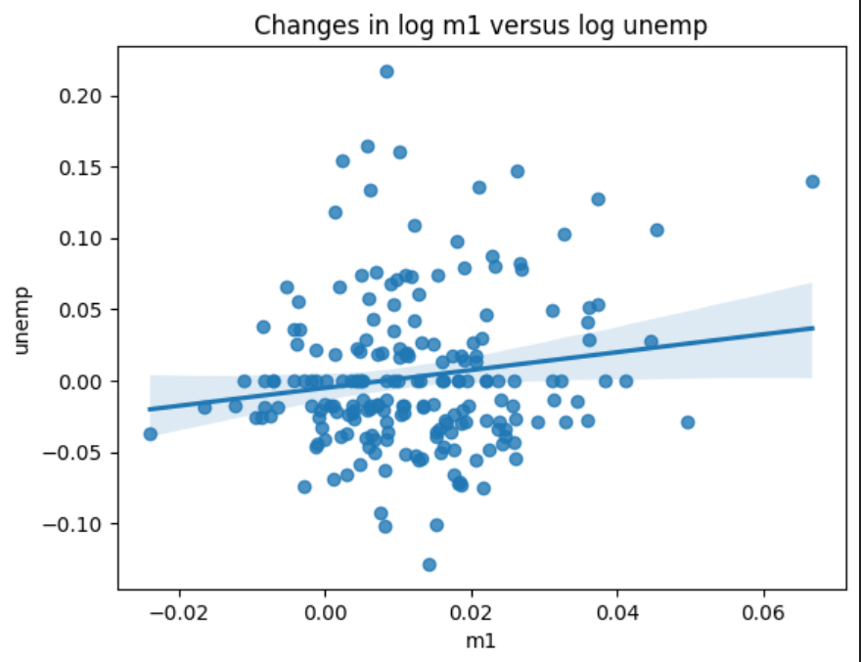

Scatter or Point Plots
Seaborn’s regplot method makes both a scatter plot and fits a linear regression line between x and y (log m1 and log unempl).

Slide 38
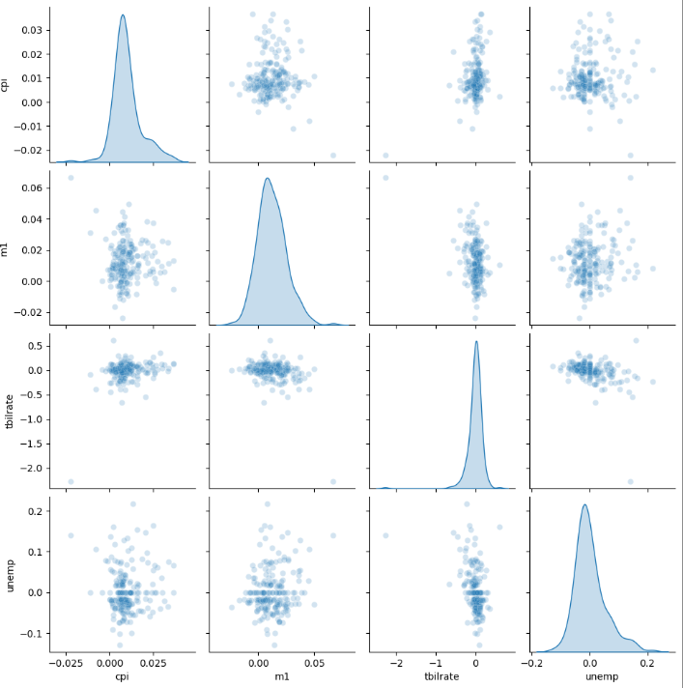

Scatter or Point Plots
scatter plot matrix or pairs plot - scatter plots among distinct variables which is helpful in exploratory data analysis.
pairplot - method to display the pair plots and density plots.

Slide 39


Facet Grids and Categorical Data
facet grid use for mapping a dataset onto multiple axes in an array format for additional grouping dimensions
Seaborn’s catplot method generates faceted plots:

Slide 40


Facet Grids and Categorical Data
Instead of grouping by ‘time’ using different colors, we can expand another row to present data.
Each grid is based on time, smoker.

Slide 41


Facet Grids and Categorical Data
catplot supports other types of plots, depending on what you want to show.
Example: box plots
Notes:
You will find more information from https://seaborn.pydata.org/

Slide 42
Other Python Visualization Tools
Alternative options for creating graphics that allow dynamic, interactive graphics in Python:
Bokeh (https://docs.bokeh.org/en/latest/index.html)
Plotly (https://github.com/plotly/plotly.py)
Static graphics on web: matplotlib plus add-on libraries like pandas and seaborn

Slide 43
References
reference
McKinney, W. (2022). Python for Data Analysis: Data Wrangling with Pandas, Numpy, and IPython. O’Reilly. (ISBN: 1-0981-0402-1)
McKinney, W. (2022). Python for Data Analysis: Data Wrangling with Pandas, Numpy, and IPython. O’Reilly. (ISBN: 1-0981-0402-1)

Slide 44

Thank you!

